Slide 2
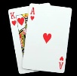
3.1 Black Jack
Lesson : Getting Acquainted with basic tools and material used for Blackjack and related mathematical concepts and processes, relevant to the game.

Slide 3
Getting Acquainted with concepts
Introduction
Blackjack is a popular American casino game, now found throughout the world. It is a banking game in which the aim of the player is to achieve a hand whose points total closer to 21 than the banker's hand, but without exceeding 21.
The game concerns with gaining money and it can be a strong motive for an adult to understand the process and the mathematical concepts and processes involved.
It is a game that can be used for Creating a Happy and Joyful Environment. Thus we can develop positive conditions for learning and hence overcome negative attitudes and anxiety.
Furthermore we can use it for Fixing Relationship Difficulties among the Learners and thus create a cooperative, challenging and joyful environment, which is an ideal condition for learning.

Slide 4
Getting Acquainted with concepts
Aim of the presentation
Clearly the playing of the game depends on two basic aspects:
(a) Getting to know the basic tools and materials needed for playing the game and their association to mathematical concepts and processes.
(b) Following the rules in actually playing the game and using mathematics in the process of keeping records of assets and their valuation.
This presentation aims at providing activities for the first of these two aspects
Activities for covering the second aspect is to be the object of another presentation/ lesson

Slide 5
Getting Acquainted with concepts
Objectives
Recognise the equivalence of values of cards to the numbers in the range 1 to 11
Count and add numbers of value 1-11 up to 21+
Read numbers up to 11
Order and compare sum of numbers up to 21
Improve memory for number cards
Understand a logical system of rules with numbers

Slide 6
Getting Acquainted with concepts
Tools Materials and Organisation
The learners/players are organised in groups of at least 2 players each, one of them being the dealer or banker.
For each group we need
A table around which the players are taking positions with a leading position for the dealer (banker) of the game
One or more decks of cards (52 each of them) depending on the number of players
Chips representing money
A list with the rules of the game and explanation of the entities involved in playing the game

Slide 7
Dealer or
Banker

Slide 9
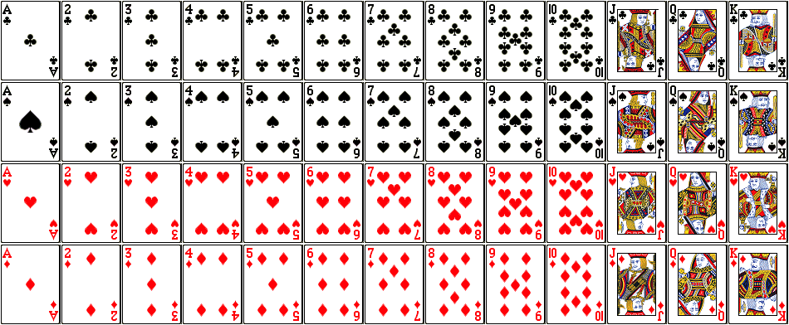

Slide 10
Getting Acquainted with concepts
Lists with
the rules of the game and identification/ explanation of the entities involved in playing the game
(see these rules in section 3.1 of the Compendium)

Slide 11
Getting Acquainted with concepts
Remarks and General Comments
A lesson of 40 to 45 minutes duration
As mentioned earlier this lesson aims at Getting to know the basic tools and materials needed for playing the game and their association to mathematical concepts and processes.

Slide 12
Getting Acquainted with concepts
Description of the Lesson
In this lesson it is proposed
To present to the students the tools and other material that are used in Blackjack and identify the connection with mathematical concepts
To demonstrate the opportunities for Creating a Happy and Joyful Environment.
To create an environment for learning supporting social relations, cooperation and productive challenge and hence overcoming negative attitudes and anxiety.
To help the learner in constructing and innovating

Slide 13
Getting Acquainted with concepts
Description of the Lesson
In this context the lesson is presented as series of the following activities:

Slide 14
Getting Acquainted with concepts
Activity 1
Understand what is a deck of cards
Examples/ Exercises (5-8 minutes)
(Refer to Worksheet 3.1.1, in the Guidebook or derive your own)

Slide 15
Getting Acquainted with concepts
Activity 2
Identify the cards, type and value
Examples/ Exercises (5-8 minutes)
(Refer to Worksheet 3.1.1, in the Guidebook or derive your own)

Slide 16
Getting Acquainted with concepts
Activity 3
Review the value of each the cards
Examples/ Exercises (5-8 minutes)
(Refer to Worksheet 3.1.1, in the Guidebook or derive your own)

Slide 17
Getting Acquainted with concepts
Activity 4
Consider various chips identify their equivalence to money
Examples/ Exercises (5-8 minutes)
(Refer to Worksheet 3.1.1, in the Guidebook or derive your own)

Slide 18
Getting Acquainted with concepts
Activity 5
Practice adding the values of two cards each time and ask participants to give the value
Examples/ Exercises (5-8 minutes)
(Refer to Worksheet 3.1.1, in the Guidebook or derive your own)

Slide 19
Getting Acquainted with concepts
Activity 6
Practice adding more than 2 cards until the total is over 21
Examples/ Exercises (5-8 minutes)
(Refer to Worksheet 3.1.1, in the Guidebook or derive your own)

Slide 20
Getting Acquainted with concepts
Activity 7
Compare random pairs of cards for their total value.
Examples/ Exercises (5-8 minutes)
(Refer to Worksheet 3.1.1, in the Guidebook or derive your own)

Slide 21
Getting Acquainted with concepts
Important Remark
The proposed distribution of time obviously depends on the skills and abilities of the learners involved.
Accordingly, and depending on their capabilities and experiences, we might have to spend much more time and the whole lesson could be split in 2 to 3 lessons of 45 minutes duration

